Slide 1

Social Media App
Bhavna Rana

Slide 2
Problem Statement
Design a comments service for a social media website which can support scalable levels of nesting.
The service should return n first level comments.
On clicking on view replies, the next level of comments should be fetched.
All the comments have associated likes and dislikes.
One clicking on the likes or dislikes the list of the users participating in the like/dislike shall be displayed

Slide 3
Assumptions & Limitations
The maximum size of a post, or a reply can be 2500 characters
All posts and replies are of type text only. Multimedia is not supported
Deletion of comments and replies is not supported
For creating a new post, or a comment, idempotency is not guaranteed

Slide 4
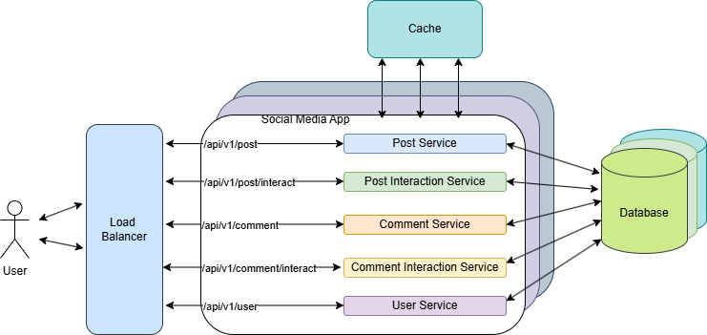
High-level Design

Slide 5
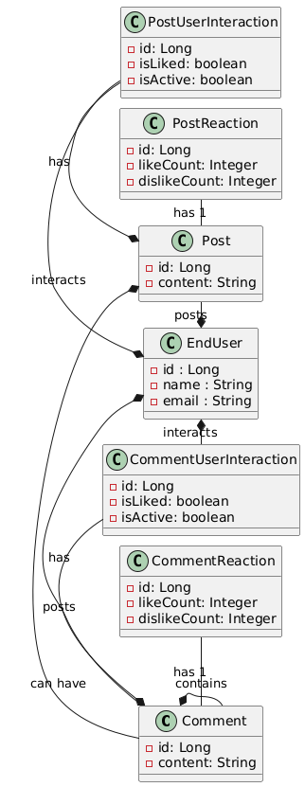
Low-level Design (Schema Design)

Slide 6
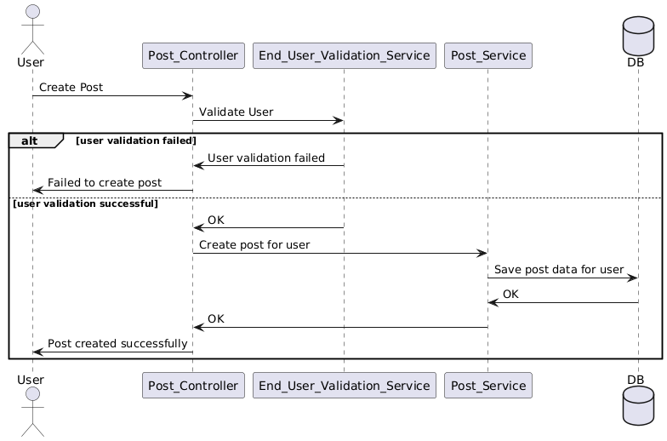
Low-level Design (Create Post Sequence Diagram)

Slide 7
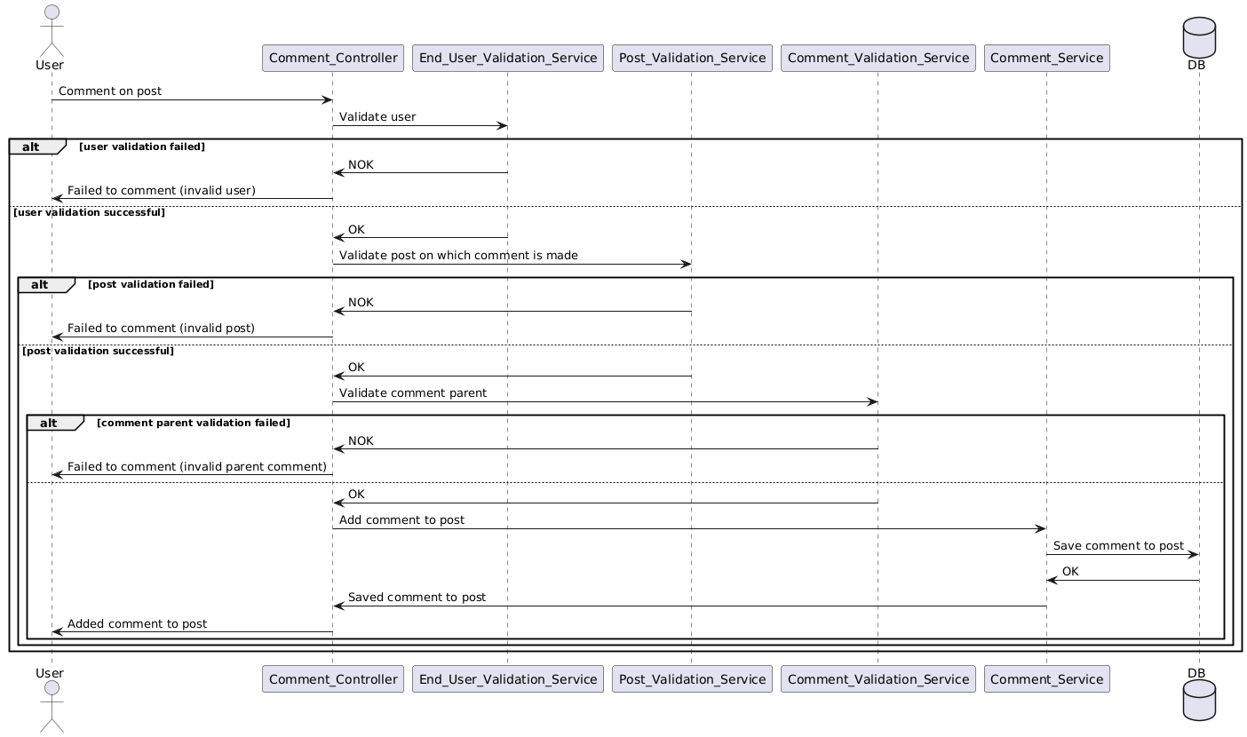
Low-level Design (Create Comment Sequence Diagram)

Slide 8
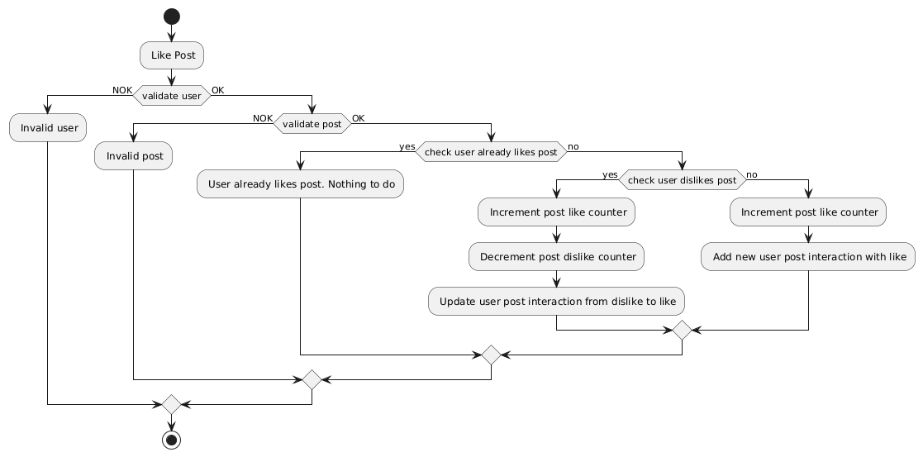
Low-level Design (Like Post Activity Diagram)

Slide 9
List of APIs

Slide 10
Demo

Slide 11
Questions?!

